Slide 1
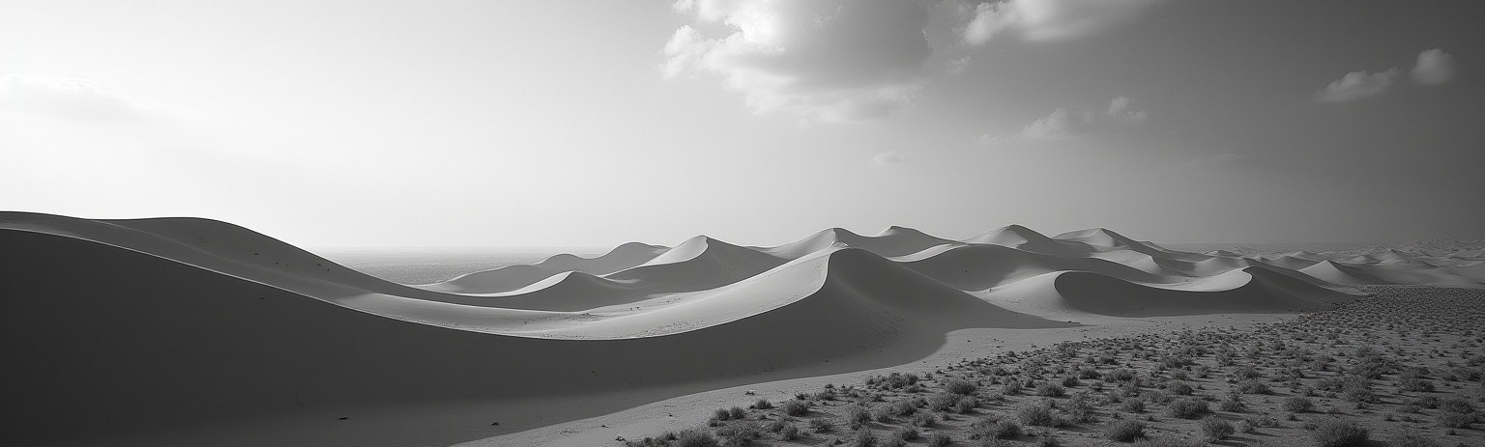
Land Classification
Sustainable Monitoring Solution for Egypt

Slide 2
Introduction
This project supports Egypts Vision 2030 by automating land-type classification using AI from Sentinel-2 satellite images. It aims to promote sustainable agriculture and environmental monitoring by providing policymakers and researchers with real-time, data-driven insights to track land use changes and support food security and development goals.

Slide 3

Project Overview and Objectives

Slide 4
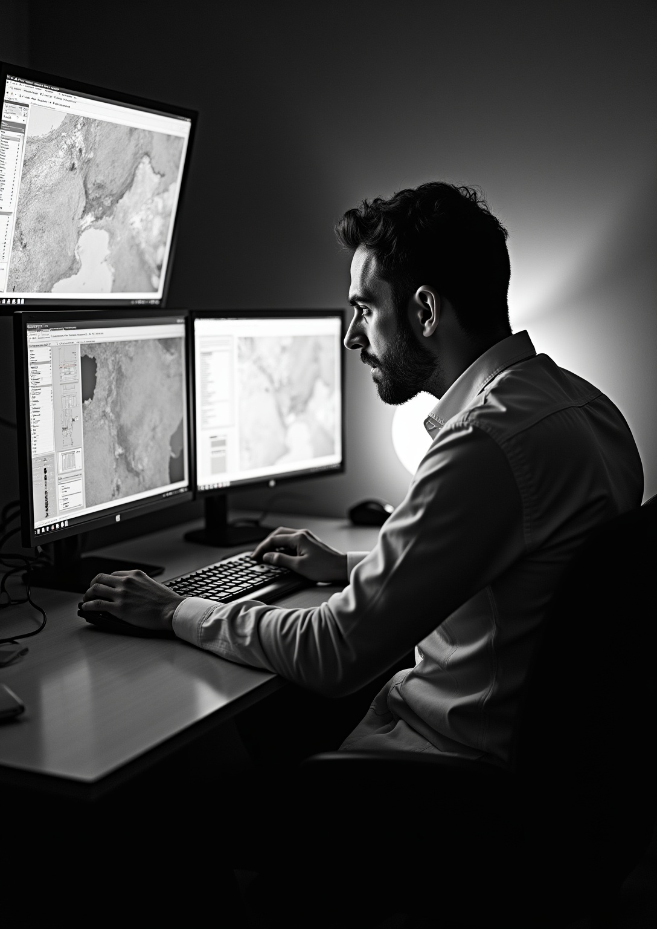
Problem Statement and Motivation
Traditional environmental monitoring and land classification are manual, time-consuming, and lack automation. There is a critical need for an AI-driven tool to detect land use changes, visualize geographic data, and provide timely environmental insights. This project addresses these challenges to enhance decision-making aligned with Egypt Vision 2030.

Slide 5
Project Scope and Data Source
The system uses Sentinel-2 RGB satellite imagery with 27,000 labeled images covering ten land classes such as agriculture, urban areas, and water bodies. It delivers land type predictions, confidence scores, interactive map visualizations, and real-time related information. End users include policymakers, researchers, and environmental analysts.

Slide 6
Alignment with Egypt Vision 2030 Goals
This project directly supports Egypt Vision 2030 by promoting sustainable agriculture and environmental monitoring. It uses AI-powered land classification to track critical land use changes impacting food security, urban expansion, and water resources. The solution offers data-driven insights to policymakers for informed planning and sustainable development, contributing to national goals of resource management and environmental protection.

Slide 7

System Design and Implementation

Slide 8
Stakeholder Analysis and Use Cases
Key stakeholders include environmental agencies, the Ministry of Agriculture, urban planners, researchers, disaster response teams, and the public. Use cases cover satellite image upload, automatic land classification, geographic mapping, retrieval of related environmental data, and interactive result dashboards, addressing diverse user needs from strategic decision-making to academic research and public awareness.

Slide 9
AI Model Architecture and Functional Requirements
The AI model is a CNN-based image classifier trained on Sentinel-2 RGB satellite images to distinguish 10 land classes. Core functional requirements include image upload, preprocessing, classification, result visualization with confidence scores, and seamless API integration. The architecture follows an MVC pattern with AI logic, front-end dashboard, and backend API connecting them efficiently.

Slide 10

Deployment, Integration, and Technology Stack
The system deploys a Flask backend integrated with the CNN model and. It leverages real-time environmental information and supports deployment on platforms. The tech stack includes Python, TensorFlow/Keras for AI, and web technologies (HTML, CSS, JS) for a responsive user interface, ensuring scalability, security, and performance.

Slide 11
Conclusions
This AI-driven land classification project offers an automated, scalable solution aligned with Egypt Vision 2030s sustainability goals. By integrating satellite imagery analysis, interactive visualizations, and real-time data retrieval, it empowers diverse stakeholders with actionable insights. The system’s modular design and robust technology stack ensure adaptability for future enhancements, supporting long-term agricultural and environmental monitoring needs.

Slide 12
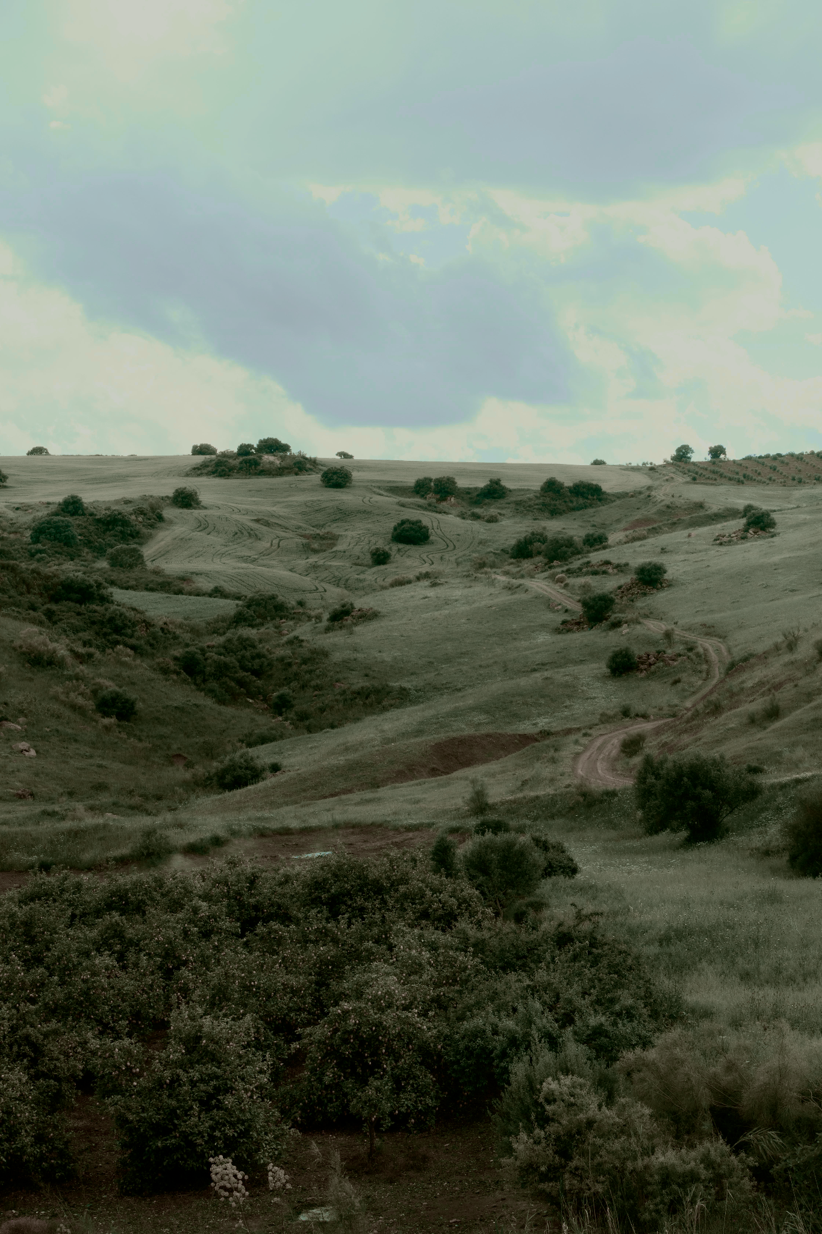
Thanks!
Do you have any questions?
youremail@freepik.com
+34 654 321 432
yourwebsite.com
Please keep this slide for attribution

